Slide 1
Structure & Scale of the solar system
Fall 2023
Exploring scale within the solar system
Creating scale models of the distance of planets/moons from the sun and comparative diameters.
Exploring the effect of gravity creating orbits
Creating a model and explanation of the effect of gravity in keeping objects in orbit within our solar system.
Comparing the weight of objects on planets or moons.
Notes:
Power of 10 video 9 minutes, start as class starts and while taking attendance

Slide 2
Driving Question:
What is the relationship between planetary mass and distance from the sun in the solar system?
How does this affect the weight of an object?
MS-ESS1-2. Develop and use a model to describe the role of gravity in the motions within galaxies and the solar system
MS-ESS1-3. Analyze and interpret data to determine scale properties of objects in the solar system.

Slide 3
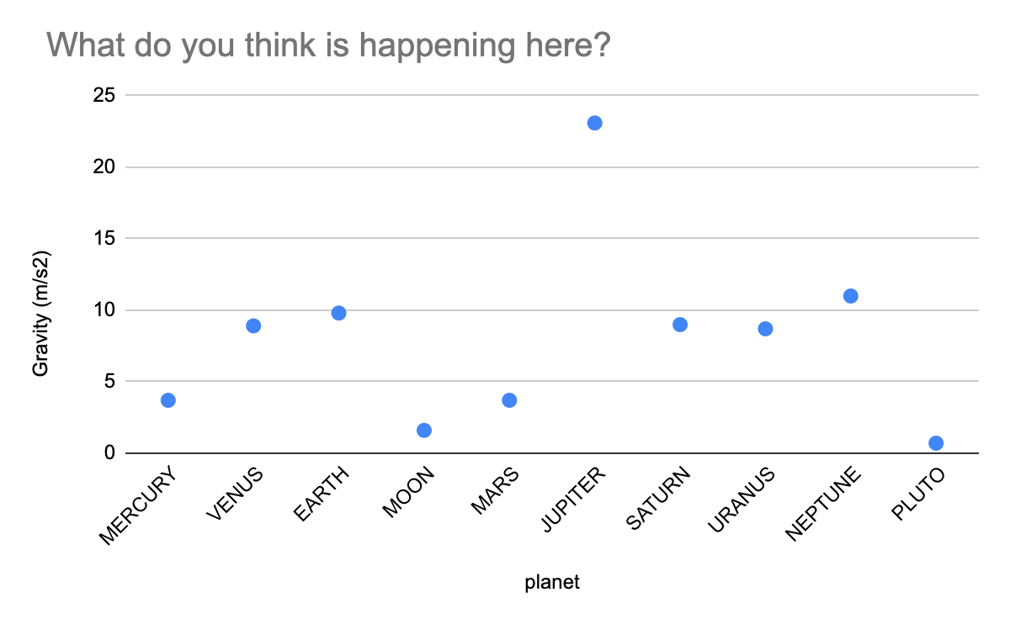

Slide 4
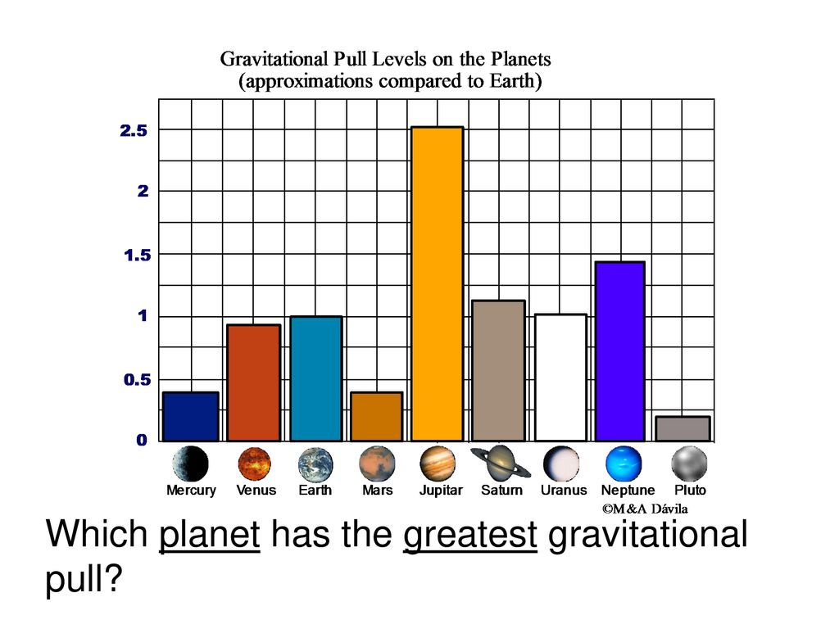

Slide 5
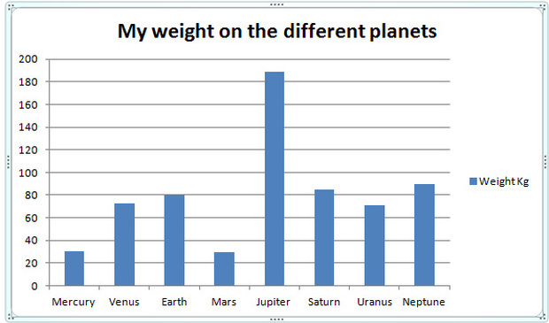

Slide 6
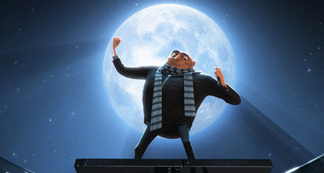
BIG QUESTION
Why doesn’t the moon (1:51) crash into Earth?
Or the Earth into the SUN?
Video (3:30)

Slide 7
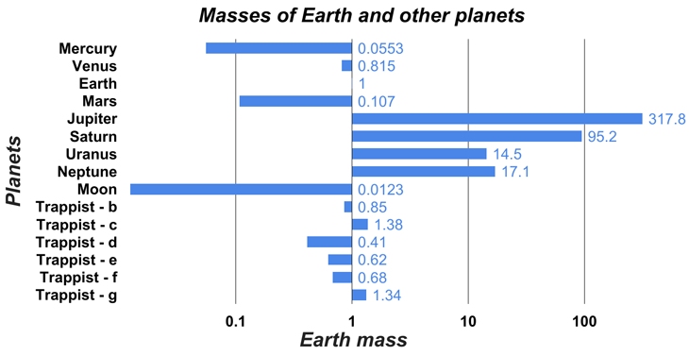

Slide 8
Data Science
Lewis and Clark
Oliver Sumner
Choose a seat, no computers today.
Please take out a pencil and a calculator if you have one.

Slide 9
What do you already know?
What is coding?
Turn and talk to your neighbor
What is data?
Turn and talk to your neighbor
Why is data important?
Turn and talk to your neighbor

Slide 10
Discussion
Introduction to Data analysis
Introduction to R
Applications of data analysis
Loading and viewing data in R

Slide 11
Introduction to R
Plot function
If you have two lists, say
“x” = (1, 2, 3) and “y” = (2, 4, 6)
using plot(x, y) will create a scatter plot with x values on the horizontal axis and y values on the vertical axis. This plot will show how y changes with x.
Sum function
If you have a list
“scores” = (10, 20, 30)
using sum(scores) would give you 60, because
10 + 20 + 30 = 60.
Mean function
For the same list
“scores“ =(10, 20, 30)
using mean(scores) would give you 20, because the average of 10, 20, and 30 is 20.

Slide 12
Analyzing Planetary Data with R
Objectives:
To understand the importance of data analysis in various fields.
Learn how to use R for basic data analysis
Analyze planetary data (mass, radius, surface gravity) using R

Slide 13
Comparing surface gravity to Mass over surface area of planets
Surface gravity on a planet is influenced by the planet’s mass and its surface area (dependent on the radius of the planet)

Slide 14
Formula for surface gravity
Where:
g is the surface gravity
G is the gravitational constant (6.674 x 10 ⁻¹¹ Nm²/kg²)
M is the mass of the planet
r is the radius of the planet
g= G x M
R²

Slide 15
Planet | Diameter (km) | Radius (km)
Mercury | 4,878.4
Venus | 12,104
Mars | 6,779
Jupiter | 139,820
Saturn | 116,464
Uranus | 50724
Neptune | 49244
Moon | Diameter (km)
Earth’s moon | 3,474.8
Callisto | 4820.6
Europa | 3121.6
Io | 3643.3
Ganymede | 5268.2
These are from your research in the fall

Slide 16
Planet | Mass (kg) | Radius (km) | Surface Area (km²) | Surface gravity (m/sec²)
Mercury | 3.3 x 10 ²³ | 2439
Venus | 4.9 x 10 ²⁴ | 6052
Earth | 5.9 x 10 ²⁴ | 6371
Mars | 6.4 x 10 ²³ | 3389.5
Jupiter | 1.9 x 10 ²⁷ | 69910
Saturn | 5.7 x 10 ²⁷ | 58232
Uranus | 8.7 x 10 ²⁵ | 25362
Neptune | 1.02 x 10 ²⁶ | 24622

Slide 17
Planet | Mass (kg) | Radius (km) | Surface Area (km²) | Surface gravity (m/sec²)
Mercury | 3.3 x 10 ²³ | 2439 | 74953988.5 | 3.7
Venus | 4.9 x 10 ²⁴ | 6052 | 460000000 | 8.87
Earth | 5.9 x 10 ²⁴ | 6371 | 509805891 | ?
Mars | 6.4 x 10 ²³ | 3389.5 | 1447577492 | 3.7
Jupiter | 1.9 x 10 ²⁷ | 69910 | 61000000000 | 24.79
Saturn | 5.7 x 10 ²⁷ | 58232 | 42000000000 | 10.44
Uranus | 8.7 x 10 ²⁵ | 25362 | 8104711154 | 8.87
Neptune | 1.02 x 10 ²⁶ | 24622 | 7638660338 | 11.15

Slide 18
How to deal with big data sets
https://posit.cloud/content/6224821

Slide 19
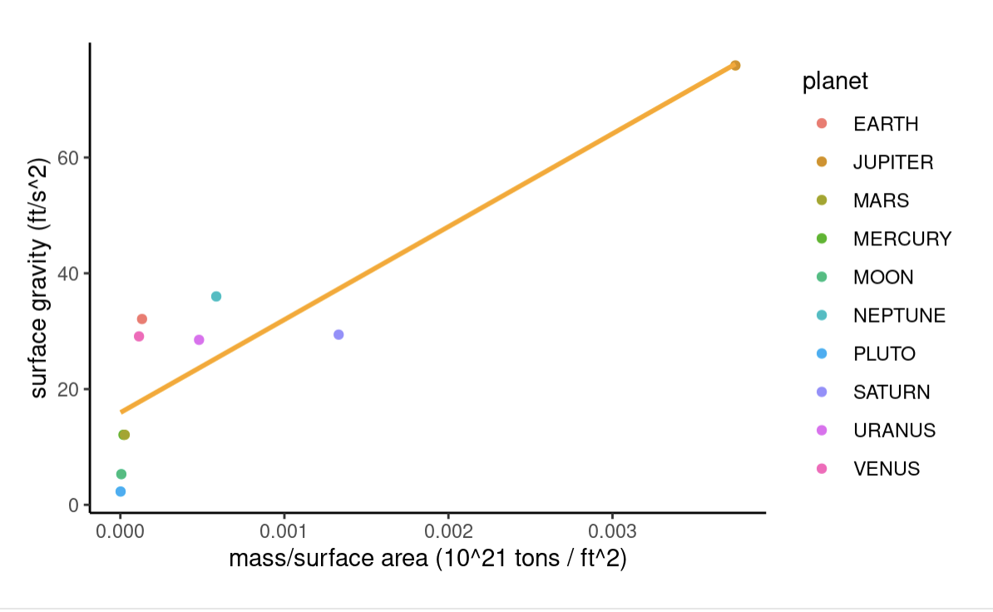

Slide 20
Questions
Which planet has the highest surface gravity and why?
How does increasing the radius of a planet (assuming mass stays the same) affect the surface gravity?
Discuss HOW the mass and radius of a planet affect its surface gravity

